Slide 1
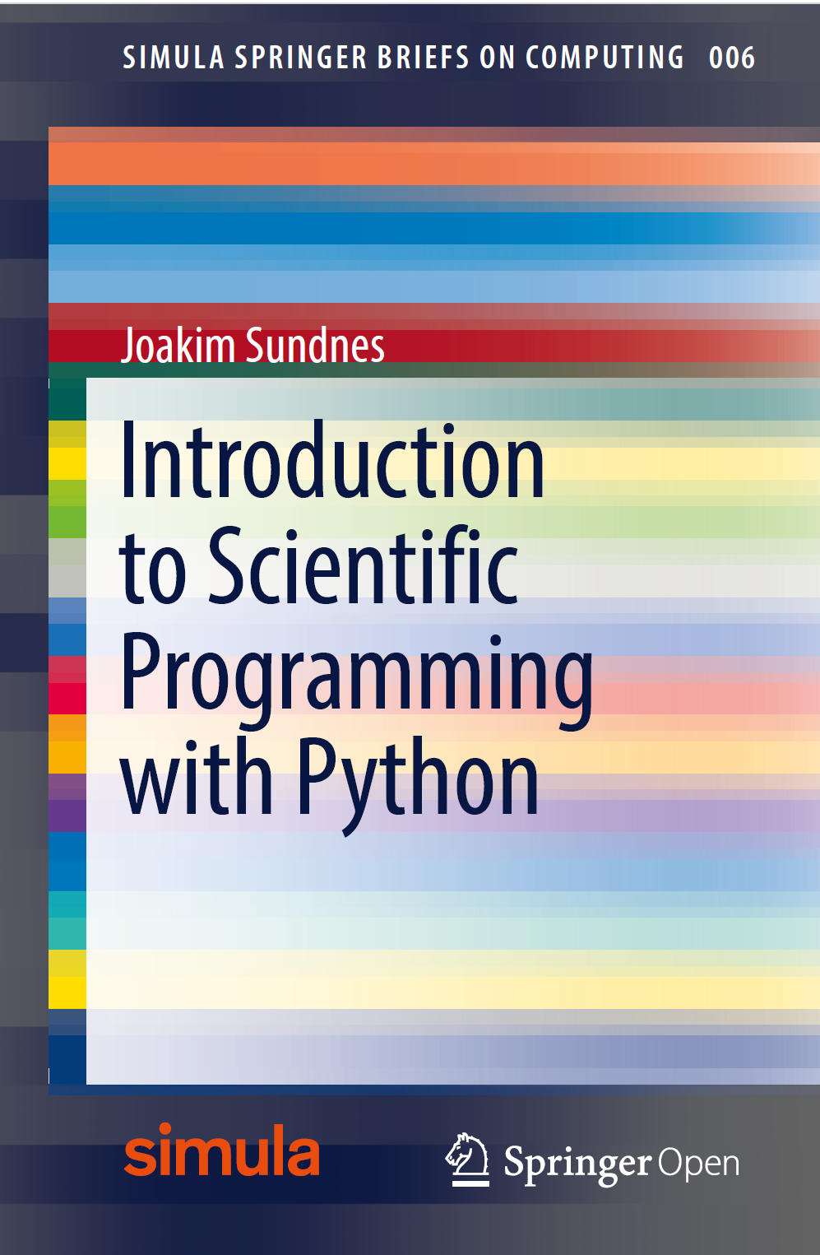
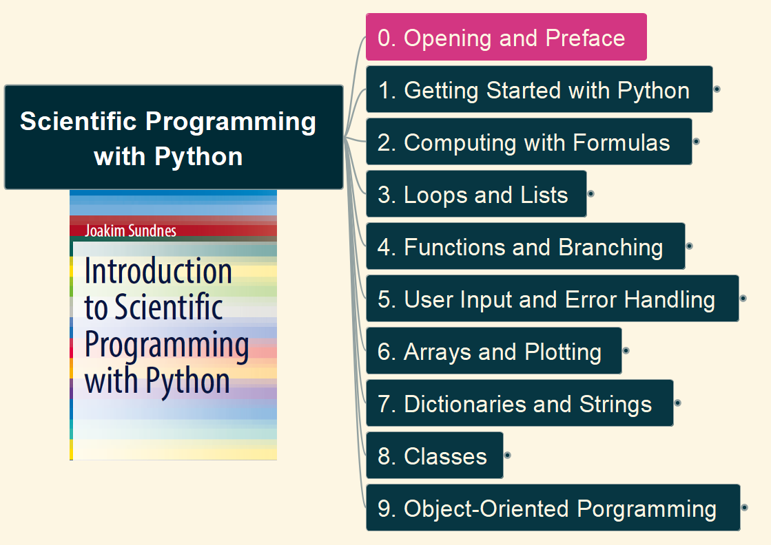
Scientific Programming with Python
001
Opening and Preface

Slide 2
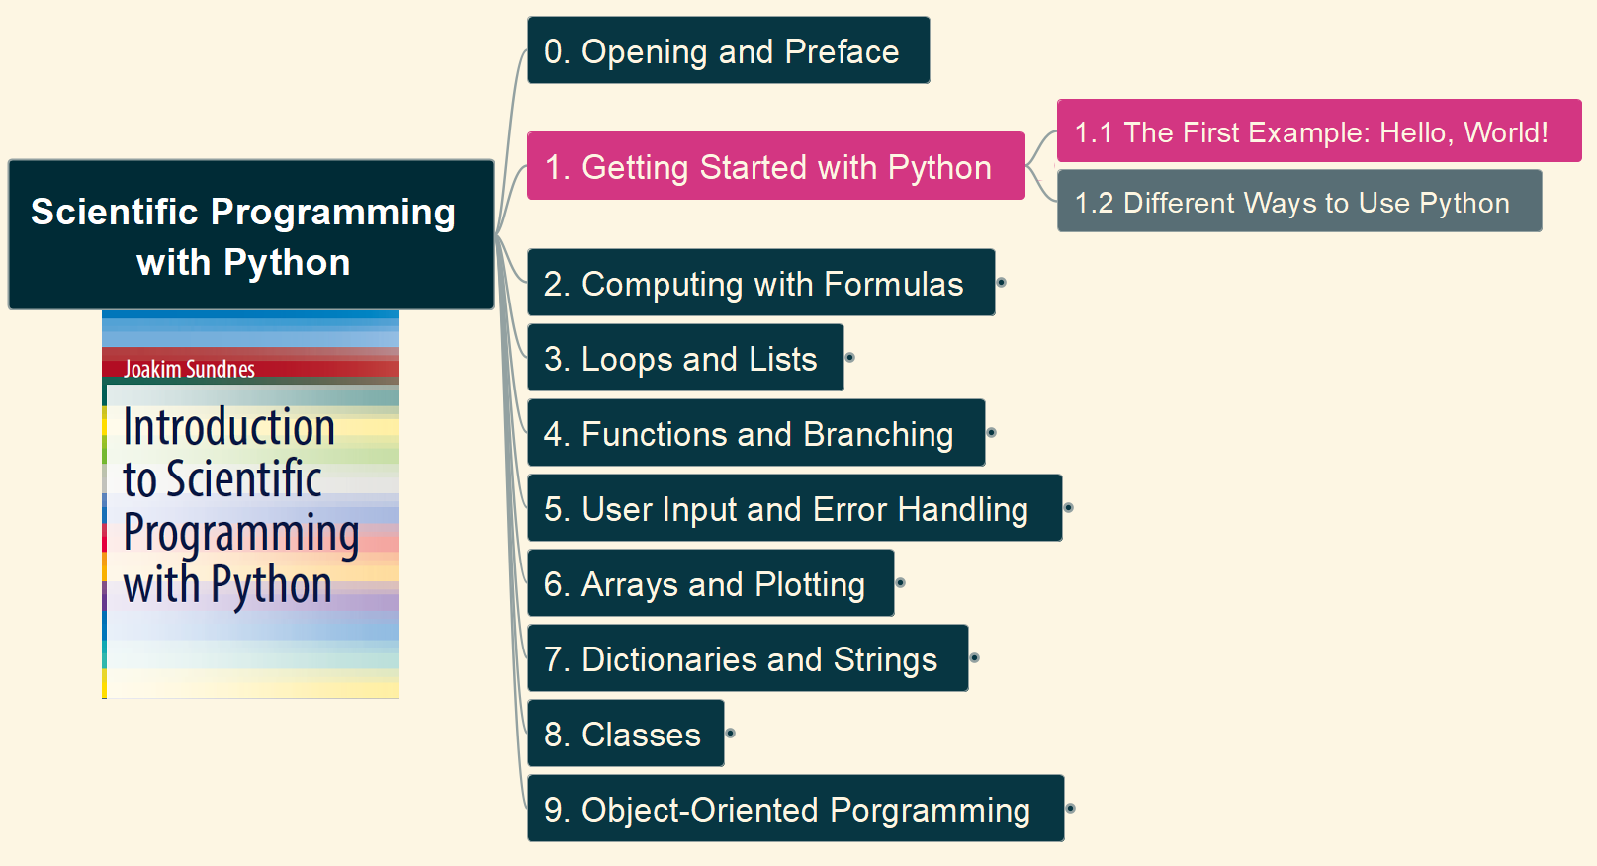
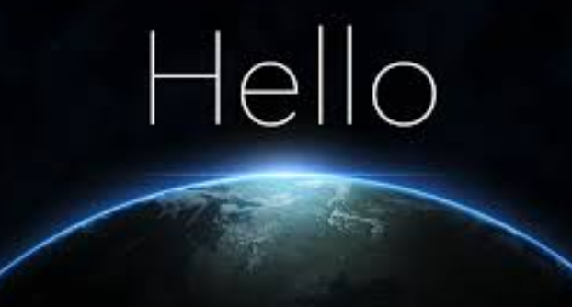
1. Getting Started with Python 1.1 The First Example: Hello, world
002

